Slide 1

RSE Parent/Carer Workshop 12.06.2025

Slide 2

Ground Rules
Respect confidentiality.
Respect other people’s viewpoints.
Don’t be afraid to share personal experiences.
No question asked in good faith is a silly question.
Engage and participate!

Slide 3

Talk Starter
“Age-appropriate relationships and sex education is important as part of a child’s learning journey through school.”
Do you agree or disagree?

Slide 4
Sessions Aims
Understand what RSE is and the rational for teaching it.
Know how and when RSE is taught at Greenside.
Gain and overview of the RSE content for your child(s) year-group.
Feel equipped in having conversations with your child(ren) about their RSE learning.
Ask and answer any questions relating to the teaching and learning of RSE.

Slide 5
What is RSE and why do schools teach it?
RSE stands for Relationship and Sex Education. It's a mandatory part of the school curriculum in the UK, designed to help children and young people develop the knowledge and skills they need as they grow up.
Enables pupils to speak with confidence and have clarity.
Helps to tackle misconceptions, misinformation and dispels fears and stigma.

Slide 6
How and when is RSE taught at Greenside?
Taught as part of our PSHE curriculum.
KS1 (Years 1 + 2): taught weekly in the Summer 2 term (starting next week)
Monday or Wednesday
LKS2 (Years 3 + 4): taught weekly in the Summer 2 term (starting next week)
Wednesday, Thursday, Wednesday
UKS2 (Years 5 + 6): taught over 2-days after the Weardale residential.

Slide 7
How and when is RSE taught at Greenside?
Children are taught in year groups – children in split classes are taught separately e.g. Anacondas and Penguins.
Boys and girls are taught together so they develop an understanding of each other’s bodies and the changes they undergo.
Year 5-6 children encouraged to anonymously ask questions. These are answered right away, deferred until the content is taught or incorporated into subsequent lessons. Past pupils have received the information very well!

Slide 8
‘Yasmine and Tom’ scheme of learning
Taught in PSHE lessons using the scheme, ‘Yasmine and Tom’ – created by the Family Planning Association which meets the Department for Education guidance on RSE.
It is age-appropriate and builds knowledge sequentially. As the children grow, so do Yasmine and Tom.

Slide 9
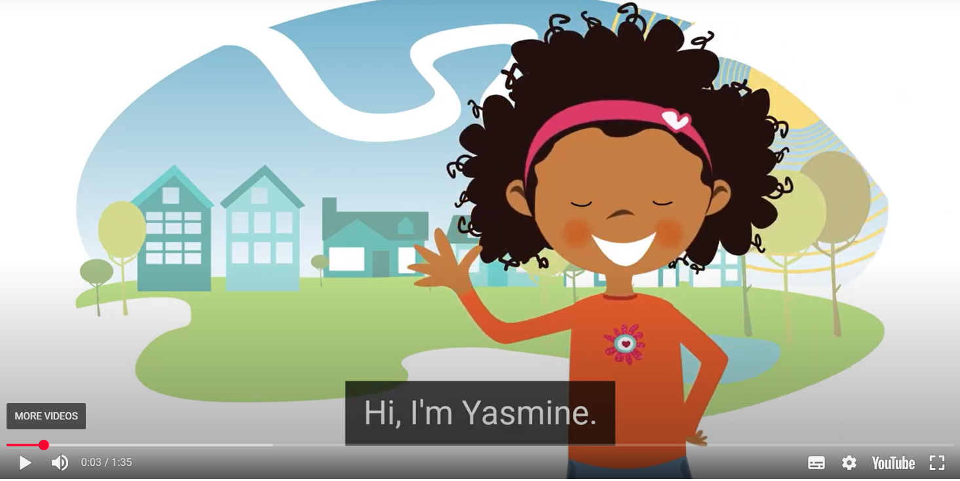
Introduction to Yasmine and Tom
Notes:
https://www.fpa.org.uk/rshe-for-parents/?utm_source=brevo&utm_campaign=Schools%20%20Important%20RSE%20Information%20for%20Parents%20from%20Schools%20-%20Resend&utm_medium=email

Slide 10
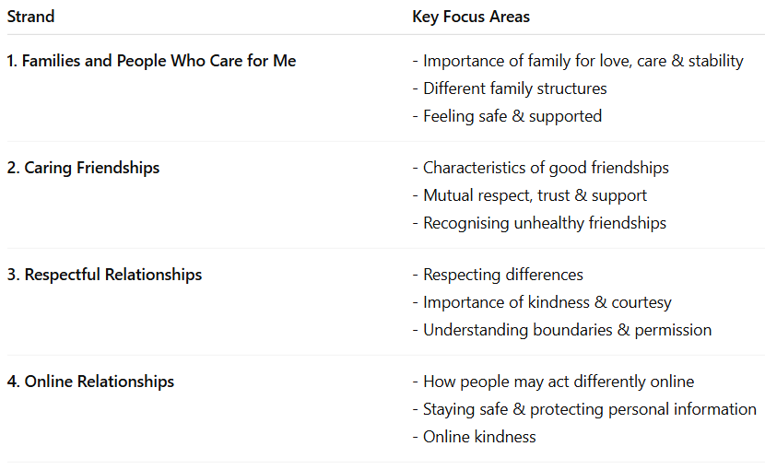
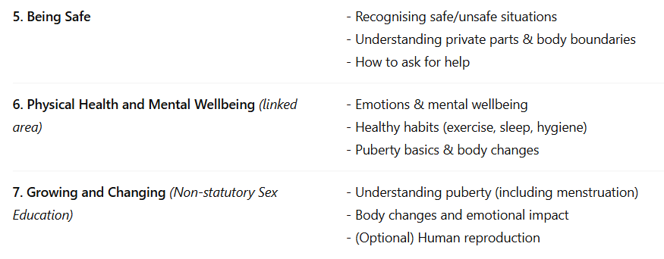
Content Coverage

Slide 11
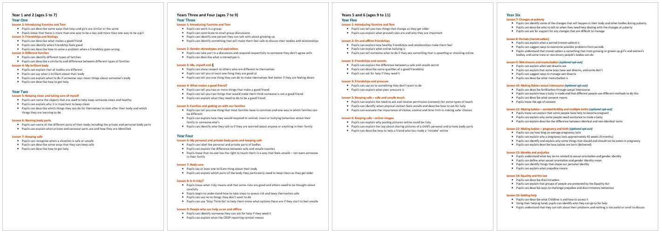
RSE content for your child(s) year-group
Please take a look at the objectives covered and feel free to ask any questions – sample interactive whiteboard.

Slide 12
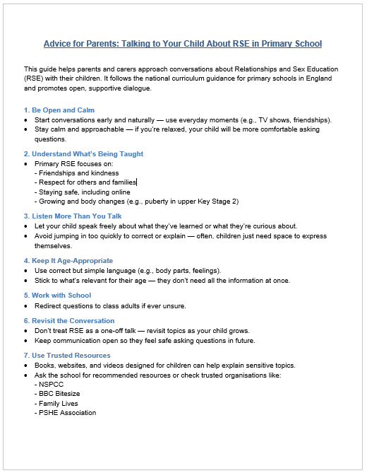
Conversations in the home about RSE
Naturally, children will want to discuss what they have learnt. If not, encourage them to share – what is their understanding?
Be calm and open - Start conversations early and naturally — use everyday moments (e.g., TV shows, friendships). If you’re relaxed, your child will be more comfortable asking questions.
Know what’s being taught – See handout
Listen more than you talk – Let your child speak freely about what they’ve learned or what they’re curious about. Avoid jumping in too quickly to correct or explain — often, children just need space to express themselves.

Slide 13
FAQ
Is there a right to withdraw, if so, what is the process?
What adaptive practices do you use to support SEND pupils?
Has there been any complaints or concerns raised in the past?
What should I do if I have a concern about the teaching of RSE?

