Slide 1
KS2 SATS Meeting
Monday 11th- Thursday 14th May 2026

Slide 2
A warm welcome!
Purpose of the meeting:
Update on national assessment arrangements
Explain school arrangements for KS2 SATs and provide reassurance about the process
Opportunity to provide information on your child’s progress and targets
Opportunity to look at sample test materials
Opportunity to order revision materials
Question and Answers

Slide 3
How are children assessed?
At the end of Year 6, children in England sit tests in:
Reading
Maths
Grammar, punctuation and spelling (GPS or SPAG)
These tests are both set and marked externally, and the results are used to measure a child’s progress through a Key Stage (from Year 3 to Year 6).
Writing is assessed through teacher judgements across a collection of work, rather than in a test format.
Your child’s marks will be sent home along with their school report. In their school report, the SATS scores are used in conjunction with teacher assessment to give a broader picture of their attainment to enable them to transition to the next stage of their learning.

Slide 4
How are the tests marked and scored?
All papers are sealed away immediately after completion and marked externally. Papers are scanned into a computer for markers to mark electronically and so we stress the importance to pupils or ensuring any answers are clear.
A pupil’s raw score (number of marks they achieve based on the number of questions they answer correctly) is converted into a scaled score.
Scaled scores range from 80-120. A pupil achieving a scaled score of 100 is judged to be ‘Meeting’ the expected standard whereas a pupil achieving 110+ is judged to be achieving the expected standard at Greater Depth. Achieving below a scaled score of 100 is reported as Working Towards the expected standard.
All pupils have their own individual scaled score target for the end of the year, this is based on previous attainment (end of Year 2).

Slide 5
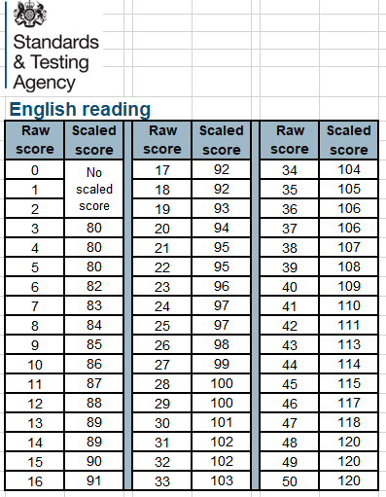
Example Scaled Score Conversion table

Slide 6



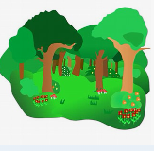


SATS Timetable - Key stage 2 2026
Monday 11th May: SPaG Paper 1: Grammar & Punctuation (45mins)
SPaG Paper 2:Spelling (15 mins)
Tuesday 12th May: Reading Paper 1 (1 hour)
Wednesday 13th May: Mathematics Paper 1: Arithmetic (30mins)
Mathematics Paper 2: Reasoning (40mins)
Thursday 14th May: Mathematics Paper 3: Reasoning (40mins)
Friday 15th May: Fun reward activities!

Slide 7



How will SATS week work?
During SATS week, school provide a free breakfast club every morning to fuel the children and give them the opportunity to chat with and spend time with their friends and school staff. We find the children love this club and it gives them the opportunity to start each day with a positive mindset.
We prepare the children for SATS week throughout the year with regular low-stakes practice time in class, revision activities and mock assessments, which we review and feedback with the children. This means the children enter SATS week knowing what will happen and feeling as prepared as possible.
For children with specific needs, there are access arrangements that we will put in place from the next SATS Mock week, and we will discuss this with relevant parents/carers at the next parents evening.
Whilst we know that it’s important for children to do their best, we recognise that every child have many skills beyond this week and want them to feel proud of their progress.

Slide 8
Grammar, Punctuation and Spelling (SPaG)
Component | Description | Number of Papers | Number of marks | Timing of component
Paper 1 Questions | Grammar, punctuation and vocabulary | 1 | 50 | 45 minutes
Paper 2 Spelling | Spelling (20 words) | 1 | 20 | 15 minutes
Total |  | 2 | 70 | 60 minutes

Slide 9
SPAG Test Pages
The GPS test includes two sub-types of questions:
Selected response, e.g. ‘Identify the adjectives in the sentence below’
Constructed response, e.g. ‘Correct/complete/rewrite the sentence below,’
or, ‘The sentence below has an apostrophe missing. Explain why it needs an apostrophe.’

Slide 11
Reading
Component | Description | Number of Papers | Number of marks | Timing of component
Paper 1 English reading test | Reading booklet and separate answer booklet A selection of texts (1500 – 2300 words) | 1 | 50 | 60 minutes (including reading time)
Total |  | 1 | 50 | 60 minutes

Slide 12
Reading Test Pages
There will be a selection of question types, including:
Ranking/ordering, e.g. ‘Number the events below to show the order in which they happen in the story’
Labelling, e.g. ‘Label the text to show the title of the story’
Find and copy, e.g. ‘Find and copy one word that suggests what the weather is like in the story’
Short constructed response, e.g. ‘What does the bear eat?’
Open-ended response, e.g. ‘Look at the sentence that begins Once upon a time. How does the writer increase the tension throughout this paragraph? Explain fully, referring to the text in your answer.’

Slide 13
Reading Test Pages

Slide 14
Mathematics
Component | Description | Number of Papers | Number of marks | Timing of component
Paper 1 arithmetic | arithmetic Assesses pupils’ confidence with the range of mathematical operations | 1 | 40 | 30 minutes
Paper 2 and Paper3: Mathematical reasoning | Mathematical fluency, solving mathematical problems and mathematical reasoning | 2 | 70 overall 35 per paper | 80 minutes 40 minutes per paper
Total |  | 3 | 110 | 110 minutes

Slide 15
Maths Paper 1: Arithmetic (40 marks in 30 minutes)
Paper 1 will consist of fixed response questions, where children have to give the correct answer to calculations, including long multiplication and division.

Slide 16
Maths Paper 2 and 3: Reasoning & Problem Solving
Papers 2 and 3 will involve a number of question types, including:
Multiple choice
True or false
Constrained questions, e.g. giving the answer to a calculation, drawing a shape or completing a table or chart
Less constrained questions, where children will have to explain their approach for solving a problem

Slide 17


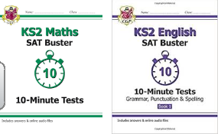
Revision Materials
http://www.satspapers.org.uk

Slide 18
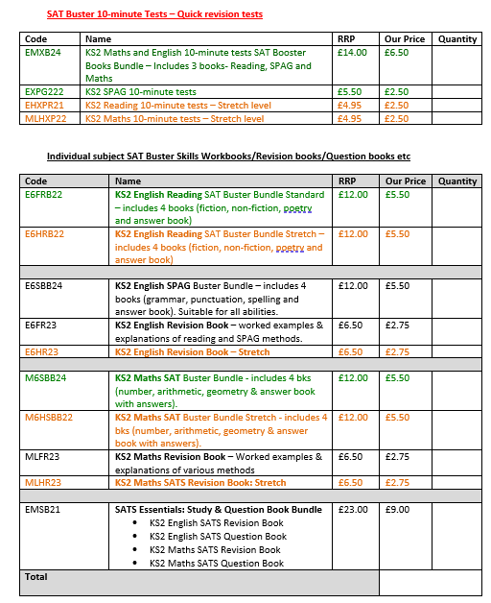
CGP Revision books are available to purchase through school at a discounted price. Please complete the form handed out at the end of this meeting by 10.02.2025 (9am) and return it to school with cash payments.

Slide 19
Your child’s progress and targets
We are really proud of the progress that children have made so far in Year 6.
To support you as parents/carers in understanding your child’s progress and individual targets, we have summarised their assessment scores from this year in a letter which you will receive at the end of this meeting. The children have already seen their scores.
Where children are further from their target, or we feel have the ability to attain higher than their target, we have lots in place at school to support this and we will be running booster groups after-school next half-term in reading and maths. Invites for the different groups will be sent out before the half-term holidays.
We hope sharing this data with you is useful and that you can celebrate the progress that has been made from September to December as well as supporting your child to continue to work hard and reach their target. We aim to motivate the children to continue making good progress as we know they are capable of this.
If you have any questions about this, please come and speak with us.

Slide 20
Summary
SATs take place on Monday 11th – Thursday 14th May 2026 – we expect 100% attendance during the tests. To encourage this, school will offer a free breakfast club from Monday-Thursday on SATs week.
How can you help?
Outstanding attendance and punctuality throughout the year.
Support at home with homework, reading, spellings, times tables.
Develop reading speed and stamina – how quickly can you read?
Practise test techniques and completing practice papers under time limits.
Liaise with school if you have any issues/concerns at any point.
Reassure your child that we want them to do their best but there is also more to life at Greenside and there is nothing to worry about!

Slide 21
Questions?

